Slide 1
Chapter 20: Software Testing
- Using JUnit, and Cobertura

Slide 2
What is JUnit?
JUnit is an open source Java unit testing framework.
JUnit features include:
  Assertions for testing expected results
  Test fixtures for sharing common test data
  Test suites for easily organizing and running tests
  Graphical and textual test runners
JUnit was originally written by Erich Gamma and Kent Beck.
20-<number>

Slide 3
JUnit Design Goals and Assumptions
If a program feature does not have an automated test, then it will not work.
The assumption is much safer than accepting a programmer's claim that the feature work and work forever.
Requires little learning by using familiar tools.
The goal is to make tests easier to write.
It supports regression testing.
It supports test reuse.
20-<number>

Slide 4
Conventional Approach and JUnit
Developers' test cases appear in different forms:
  print statements
  debugger expressions
  test scripts
JUnit implements test cases as objects using the command pattern
  to provide a uniform treatment of test cases
  to encapsulate test requests as an object
20-<number>

Slide 5
Creating Test Cases in JUnit
Three simple steps:
  create a subclass of TestCase.
  write test cases as
    public void test<TestCaseName>() { ... } methods
  write a public static Test suite() method that adds the test cases to the test suite.
Compile the subclass and the component under test and run it in a Test Runner.
20-<number>

Slide 6
Creating Test Cases in JUnit
public class SimpleTest extends TestCase
{
public void testMax() {
int x=Math.max(5,10);
assertTrue(x>=5 && x>=10);
}
public void testDivideByZero()
  {int zero= 0; int result= 8/zero;}
  public static Test suite()
  { return new TestSuite (SimpleTest.class); }
}
20-<number>

Slide 7
How to Compile
Command line:
javac –classpath junit.jar;<yourclasspath> -d <destination directory> <your source files>
Today, JUnit is integrated into most of the IDEs. Follow the instruction given by the IDE to compile and run JUnit tests.
20-<number>

Slide 8
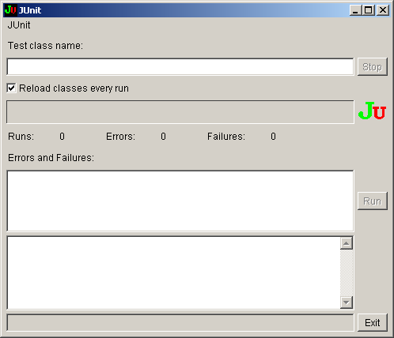
Running JUnit Tests
java -cp junit.jar;<your_classpath> junit.awtui.TestRunner
20-<number>

Slide 9
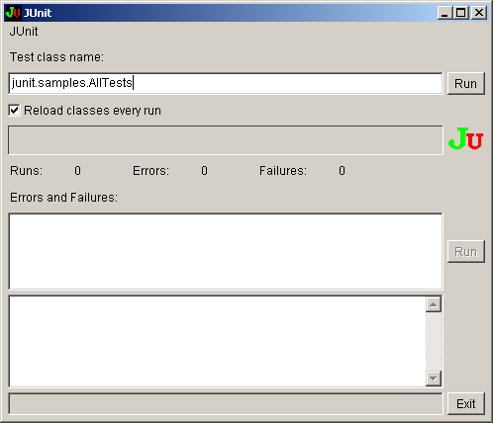
Enter the fully qualified TestCase class name and click Run
20-<number>

Slide 10
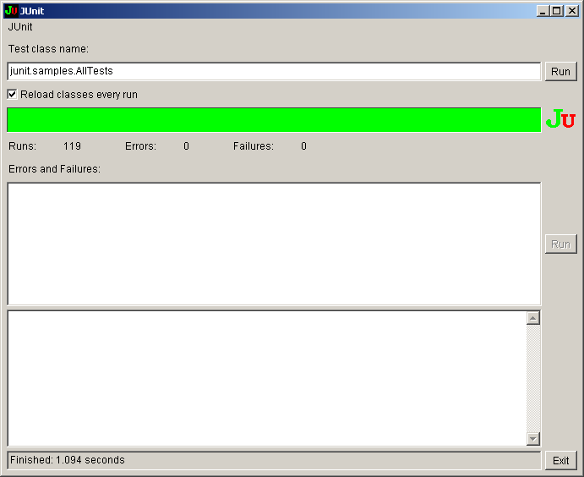
119 tests run successfully.
20-<number>

Slide 11
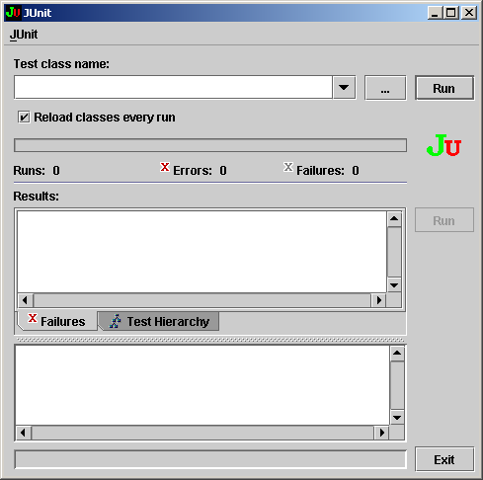
JUnit Swing User Interface
java -cp junit.jar;<your_classpath> junit.swingui.TestRunner
20-<number>

Slide 12
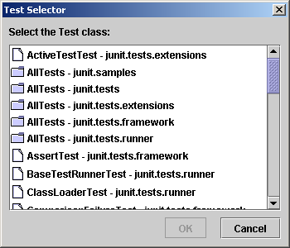
JUnit Swing User Interface
Swing interface allows you to browse the directory.
20-<number>

Slide 13
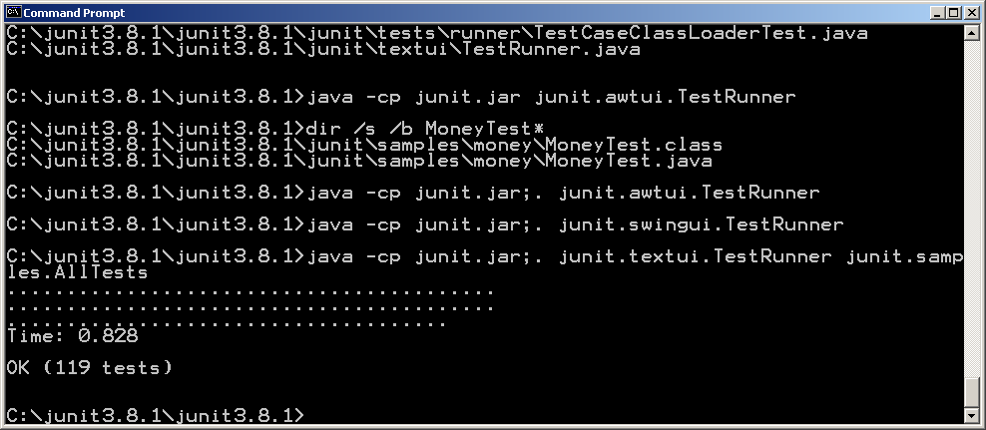
JUnit Text User Interface
java -cp junit.jar;. junit.textui.TestRunner junit.samples.AllTests
20-<number>

Slide 14
Usefulness of Text UI?
You can redirect test output to a text file, and process the file to process the test output.
This is done by calling the static
  System.setOut(PrintStream out) method:
  try {
  PrintStream ps=new PrintStream (
  new FileOutputStream(“output-file.txt"));
  System.setOut(ps);
  // invoke JUnit Text UI Runner here
  ps.flush();
  ps.close();
  } catch (IOException e) {
  e.printStackTrace();
  }
  // process output-file.txt here.
20-<number>

Slide 15
Error and Failure
Failures are anticipated failed conditions.
The tester tests for failure using the assertion methods:
  public void testAdd()
  { double result= 2+3; assertTrue(result == 6); }
Errors are unanticipated failed conditions that cause runtime exceptions:
  public void testDivideByZero()
  {int zero= 0; int result= 8/zero;}
20-<number>

Slide 16
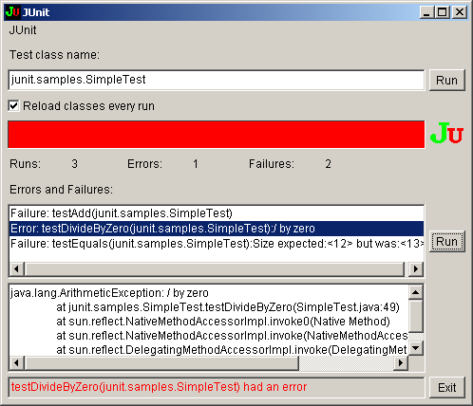
Error and Failure
20-<number>

Slide 17
The Manual and Automatic Ways
public class SimpleTest extends TestCase
{ public void testDivideByZero()
  {int zero= 0; int result= 8/zero;}
  public static Test suite() {
  TestSuite suite= new TestSuite();
  suite.addTest(new SimpleTest ("testDivideByZero") {
  protected void runTest()
  { testDivideByZero(); }
  });
  return suite;}
  }
public class SimpleTest extends TestCase
{ public void testDivideByZero()
{ int zero= 0; int result= 8/zero;}
public void testAdd()
  { double result= 2+3; assertTrue(result == 6); }
  public static Test suite() {
return new TestSuite
(SimpleTest.class);
}
}
20-<number>

Slide 18
Using Test Fixture
A test fixture is an object used by one or more test cases.
  public class VectorTest extends TestCase {
  protected Vector fEmpty, fFull; // fixtures
  protected void setUp() { // setup the fixtures
  fEmpty= new Vector(); fFull= new Vector();
  fFull.addElement(new Integer(1));
  fFull.addElement(new Integer(2));
  fFull.addElement(new Integer(3));
  }
  }
20-<number>

Slide 19
Using Test Fixture
public void testCapacity() {
int size= fFull.size();
for (int i= 0; i < 100; i++)
fFull.addElement(new Integer(i));
assertTrue(fFull.size() == 100+size);
}
public void testContains() {
assertTrue(fFull.contains(new Integer(1)));
assertTrue(!fEmpty.contains(new Integer(1)));
}
20-<number>

Slide 20
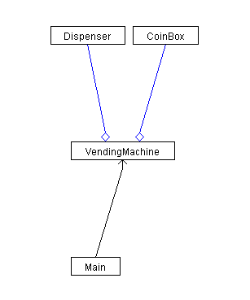
Testing a Vending Machine
20-<number>

Slide 21
The CoinBox Code
package coinbox;
import java.io.*;
public class CoinBox
{
private int curAmt, total;
public int getCurAmt () { return curAmt; }
public void insertCoin (int amt)
throws InvalidCoinException
{ if (amt!=5&&amt!=10&&amt!=25)
{
throw new InvalidCoinException();
}
this.curAmt += amt;
System.out.println ("Current Amount is "+curAmt);
}
20-<number>

Slide 22
public int getTotal () { return total; }
public void makeChange (int price )
throws InvalidPriceException
{ if (price<=0)
{
throw new InvalidPriceException();
}
release(curAmt-price);
curAmt = 0;
total += price;
}
private void release (int amt)
{ System.out.println ("Release "+amt); }
public void returnCoin ()
{ release (curAmt); curAmt=0; }
}
20-<number>

Slide 23
Testing the CoinBox
import junit.framework.*;
public class CoinBoxTest extends TestCase
{ private CoinBox coinBox;
public CoinBoxTest(String testCaseName)
{ super(testCaseName); }
public void setUp() {coinBox=new CoinBox();}
public void testTotal() throws InvalidCoinException
{for(int i=1; i<=10; i++) coinBox.insertCoin(10);
int total=coinBox.getTotal();
assertTrue("Total="+total+" Expected=100", total==100);
}
}
20-<number>

Slide 24
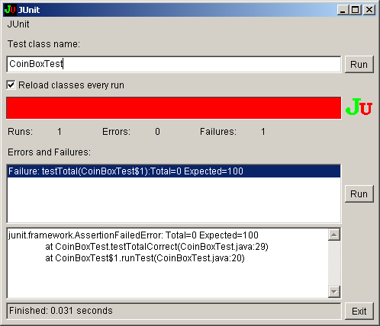
CoinBox testTotal Failed
20-<number>

Slide 25
CoinBox testCurAmt()
public void testCurAmt() throws InvalidCoinException,
InvalidPriceException
{ for(int i=1; i<=10; i++)
coinBox.insertCoin(10);
int curAmt=coinBox.getCurAmt();
assertTrue("curAmt="+curAmt+
"Expected=100", curAmt==100);
}
20-<number>

Slide 26
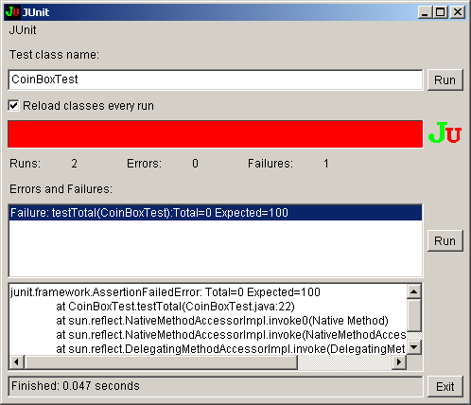
20-<number>

Slide 27
Exercise
Assume an integer stack has been implemented with the following methods:
  boolean empty ()
  boolean full()
  int pop()
  void push(int x)
Write code to test the stack using boundary value analysis testing technique. Assume the stack can store 5 integers. Name the test case class StackTest.
20-<number>

Slide 28
Lab Exercise
Download JUnit
  http://prdownloads.sourceforge.net/junit/junit3.8.1.zip?download
Unzip to a clean directory. The installation is done.
Implement the integer stack.
Complete the implementation of the StackTest class.
Compile Stack and StackTest classes.
Run the test cases in TestRunner.
20-<number>

Slide 29
Running JUnit in NetBeans
1. Click Run->Set Project Configuration -> Customize...
2. In the Project Properties dialog that is displayed, click Run in the Categories list.
3. In the Main Class text field, fill in the test runner you want to use, e.g., “junit.swingui.TestRunner.”
4. In the Arguments text field, enter the fully qualified TestCase subclass name, e.g., “test.example.PurgeTest.”
5. Click OK.
20-<number>

Slide 30
JCoverage, Cobertura, and Emma
Both are latest Java coverage tools. Cobertura is built on top of JCoverage.
JCoverage is a NetBeans plugin.
It is easy to run these tools in NetBeans. Use of Cobertura is recommended.
They support branch coverage and line coverage.
Emma is another coverage tool. But Emma may not provide branch coverage.
20-<number>

Slide 31
Running a Plugin in NetBeans
Step 1. Installation. Select Tools->Plugins, check the \Code Coverage Plugin" check-box in the list of available plugins, click Install and follow the instructions.
Step 2. Activation. Right click the project name in Projects view and select Coverage->Activate Coverage Collection. The tool is activated for the project.
Step 3. Execution. Do as “Run JUnit in NetBeans.”
Step 4. Viewing result. Right click on the project name and choose Coverage->Show Project Coverage Statistics. To see which lines of a class are exercised and which are not, double click the class name in Project view (green lines are covered completely, yellow lines are covered partially, and the rest are not covered).
20-<number>

Slide 32
Setting Up Cobertura in NetBeans
Copy the build.xml and build.properties files in the cobertura-1.9.3\examples\basic directory to your NetBeans project directory.
Rename the copies as cobertura-build.xml and cobertura-build.properties, respectively.
In the cobertura-build.properties file, change the line “cobertura.dir=../..” to refer to the path that contains the cobertura.jar file. It should be the path to the cobertura-1.9.3 directory.
Save the updated file.
(to be continued)
20-<number>

Slide 33
Setting Up Cobertura in NetBeans
(Optional.) Move your test case Java source files from the project test directory to the project src directory. You may need to do this if your version of Cobertura only checks the src directory for the test case source files. You may change the cobertura-build.xml file to avoid moving the test files.
20-<number>

Slide 34
Running Cobertura in NetBeans
Expand the cobertura-build.xml file in the Files view, right-click the main task and choose Run Target. You should see the compile, instrument, run tests, and collect coverage information tasks being executed.
If all tasks run successfully, you should see the coverage information in the reports directory under the project directory.
Expand the cobertura-html directory to see a listing of html files.
Right-click the index.html file and select View from the pop-up menu to view the Coverage Report.
Right-click the index.html file under the junit-html directory and select View to see the unit test results.
20-<number>

Slide 35
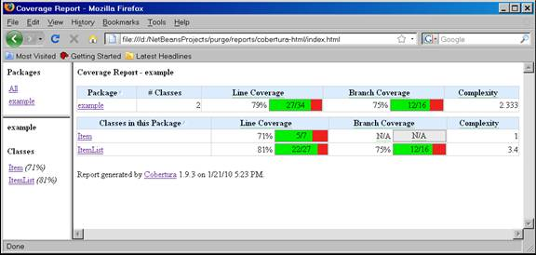
Cobertura Coverage Report
20-<number>

Slide 36
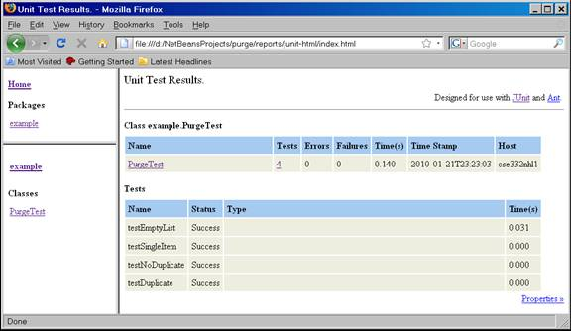
Cobertura Unit Test Report
20-<number>

Slide 37
More About Junit
The following slides provide more about the design of the JUnit test tool.
These slides may be skipped.
20-<number>

Slide 38
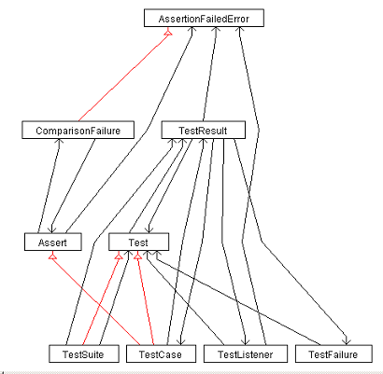
JUnit Framework Classes
20-<number>

Slide 39
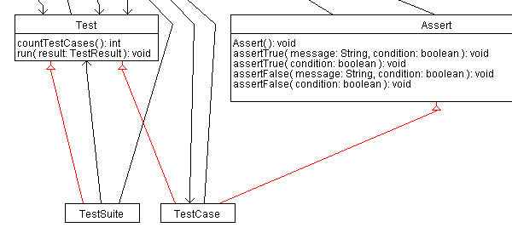
The Test Interface and Assert Class
// more
20-<number>

Slide 40
The Assert Class
The Assert class has the following types of methods:
  methods for asserting
    that two variables (including objects) are equal
    that two object references refer to the same object
    that two object references not refer to the same object
    that an object reference is null or not null
    these methods may or may not have a informative message
  methods for throwing an assertionFailedError exception which may or may not include a message
20-<number>

Slide 41
Methods that Throw Exceptions
static public void fail(String message) {
throw new AssertionFailedError(message);
}
following methods use above method
  fail( ): void gives no message
  failSame(msg: String): void msg+" expect the same"
  failNotSame( msg: String, expected: Object, actual: Object ): void expect not the same objects
  failNotEquals( msg: String, expected: Object, actual: Object ): void expect not equal objects
20-<number>

Slide 42
The Assertion Methods
The simplest one is
  protected void assert(boolean condition) {
  if (!condition)
  throw new AssertionFailedError();
  }
20-<number>

Slide 43
Methods to Assert Equals
Syntax:
  assertEquals([String message,] type expected, type actual)
Semantics:
  if (! expected.equals(actual))
  throws assertFailedError(message+" was expected to be equal.")
type can be object or primitive types
20-<number>

Slide 44
List of assertEquals Methods
assertEquals( expected: double, actual: double, delta: double ): void
assertEquals( message: String, expected: float, actual: float, delta: float ): void
assertEquals( expected: float, actual: float, delta: float ): void
assertEquals( message: String, expected: long, actual: long ): void
assertEquals( expected: long, actual: long ): void
assertEquals( message: String, expected: boolean, actual: boolean ): void
assertEquals( expected: boolean, actual: boolean ): void
assertEquals( message: String, expected: byte, actual: byte ): void
assertEquals( expected: byte, actual: byte ): void
assertEquals( message: String, expected: char, actual: char ): void
20-<number>

Slide 45
List of assertEquals Methods
assertEquals( expected: char, actual: char ): void
assertEquals( message: String, expected: short, actual: short ): void
assertEquals( expected: short, actual: short ): void
assertEquals( message: String, expected: int, actual: int ): void
assertEquals( expected: int, actual: int ): void
assertEquals( message: String, expected: Object, actual: Object ): void
assertEquals( expected: Object, actual: Object ): void
assertEquals( message: String, expected: String, actual: String ): void
assertEquals( expected: String, actual: String ): void
assertEquals( message: String, expected: double, actual: double, delta: double ): void
20-<number>

Slide 46
Null Test Methods
These methods can be used to test if an object is null or not null
  assertNotNull( object: Object ): void
  assertNotNull(message: String, object: Object): void
  assertNull( object: Object ): void
  assertNull( message: String, object: Object ): void
20-<number>

Slide 47
Methods to Test If Same Object
assertNotSame( expected: Object, actual: Object ): void
assertNotSame( message: String, expected: Object, actual: Object ): void
assertSame( expected: Object, actual: Object ): void
assertSame( message: String, expected: Object, actual: Object ): void
20-<number>

Slide 48
Methods to Test a Condition
assertTrue( message: String, condition: boolean ): void
assertTrue( condition: boolean ): void
assertFalse( message: String, condition: boolean ): void
assertFalse( condition: boolean ): void
20-<number>

Slide 49
The TestCase Class
It uses the command pattern to encapsulate a request to run a test case.
It is an abstract class.
All concrete test cases are derived from TestCase.
It inherits from Assert and implements Test.
<<interface>>
Test
Assert
<<command>>
TestCase
name
run()
20-<number>

Slide 50
TestCase Uses Template Method
Template method defines a template for the algorithm, letting
subclasses to implement some of the steps.
<<interfaced>>
Test
Assert
<<template method>>
run() {
  setUp();
  runTest();
  tearDown();
}
<<command>>
TestCase
name
run()
#setUp()
runTest()
#tearDown()
20-<number>

Slide 51
Collecting Test Results
Test results are collected by passing a TestCase
object to TestResult using the collecting
parameter pattern.
<<sync>>
{fRunTests++;}
<<command>>
<<coll. para.>>
TestCase
TestResult
  {
  result.startTest(this);
  setUp();
  runTest();
  tearDown();
  }
name
fRunTests:int
run(result)
#setUp()
runTest()
#tearDown()
startTest (testCase)
TestResult()
{fRunTests= 0;}
20-<number>

Slide 52
Collecting Test Results
public class TestResult extends Object {
protected int fRunTests;
  public TestResult() {
  fRunTests= 0;
  }
  }
  public void run(TestResult result) { // of TestCase
  result.startTest(this);
  setUp();
  runTest();
  tearDown();
  }
20-<number>

Slide 53
Catching Failures and Errors
public void run(TestResult result) {
result.startTest(this);
setUp();
try {
runTest();
}
catch (AssertionFailedError e) { // catch anticipated failure
result.addFailure(this, e);
} catch (Throwable e) { // catch unanticipated error
result.addError(this, e);
}
finally {
tearDown();
}
}
20-<number>

Slide 54
Using Adapter and Pluggable Selector
public class SimpleTest extends TestCase
{ public void testDivideByZero()
  {int zero= 0; int result= 8/zero;}
  public static Test suite() {
  TestSuite suite= new TestSuite();
  suite.addTest(new SimpleTest ("testDivideByZero") {
  protected void runTest()
  { testDivideByZero(); }
  });
  return suite;}
}
public class SimpleTest extends TestCase
{ public void testDivideByZero()
{ int zero= 0; int result= 8/zero;}
public void testAdd()
  { double result= 2+3; assertTrue(result == 6); }
  public static Test suite() {
return new TestSuite
(SimpleTest.class);
}
}
20-<number>

Slide 55
Using Adapter
public class SimpleTest extends TestCase
{ public void testDivideByZero()
  {int zero= 0; int result= 8/zero;}
  public static Test suite() {
  TestSuite suite= new TestSuite();
  suite.addTest(new SimpleTest ("testDivideByZero") {
  protected void runTest()
  { testDivideByZero(); }
  });
  return suite;}
}
The adapter adapts the method that implements a test case to the required runTest () interface.
It is an anonymous inner class.
TestCase
SimpleTest
Adapter
20-<number>

Slide 56
Using Pluggable Selector
public class SimpleTest extends TestCase
{ public void testDivideByZero()
{ int zero= 0; int result= 8/zero;}
public void testAdd()
  { double result= 2+3; assertTrue(result == 6); }
  public static Test suite() {
return new TestSuite
(SimpleTest.class);
}
}
pluggable selector stores a method name in an instance variable, i.e., fName in TestCase.
JUnit then uses Java reflection to invoke the method using fName.
On the left, JUnit simply invokes all methods begin with "test" in the name.
20-<number>

Slide 57
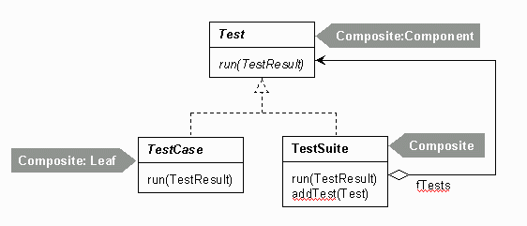
TestSuite Is a Composite
20-<number>

